Slide 1
VEHICLE NUMBER PLATE RECOGNITION
Priyal Dighe (16)
Kunal Nimbalkar (32)
Omkar Pol (33)
Raj Aryan (35)

Slide 2

INTRODUCTION
Technology - Optical Character Recognition and Image Processing
Capture Image -> Process -> Extract
Use Cases
Vehicle Parking Traffic Management Toll Enforcement
Security and Law Enforcement

Slide 3
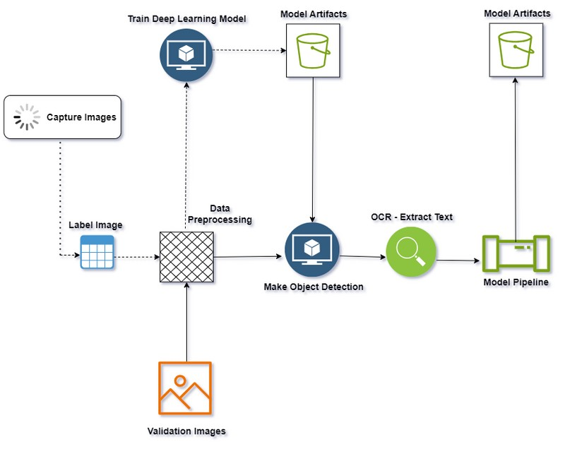

PROJECT ARCHITECTURE
Consist of several key components each serving a specific purpose
Based on the specific requirements of the application

Slide 4
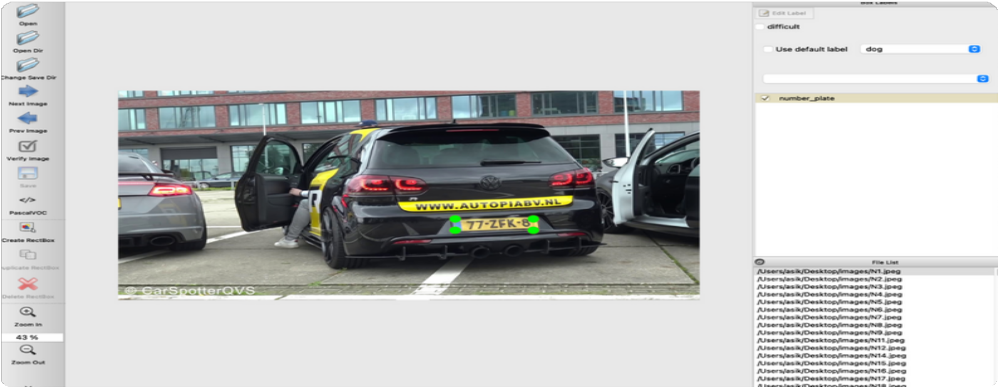
LABELING
Collect - Vehicle Image with number plates
Label Image - LabelImg Annotation Tool
GUI - Draw Rectangle Box Save the output in XML

Slide 5
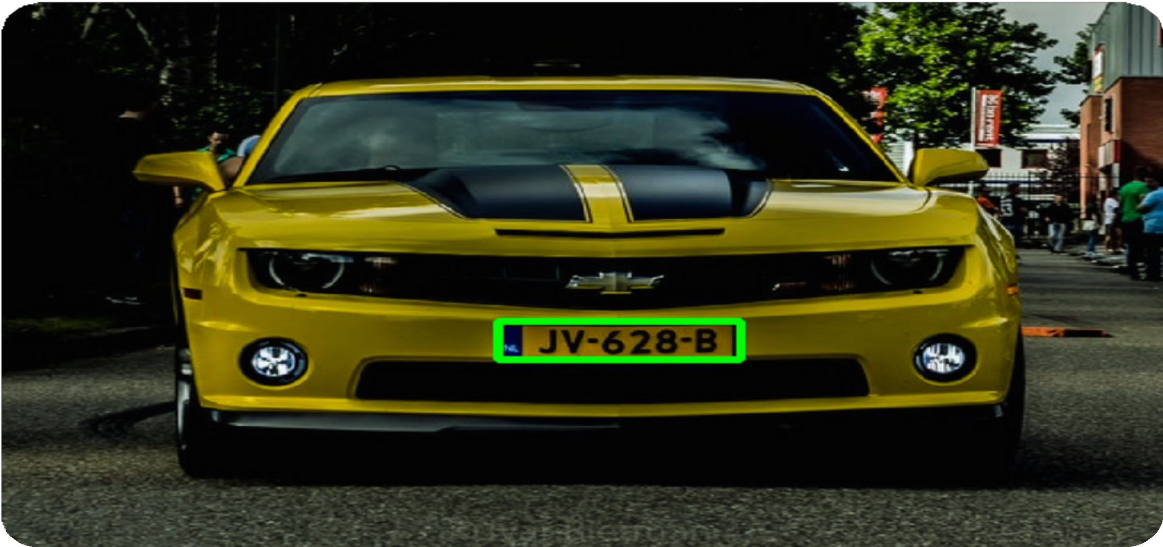
LABELING (CONT...)
Parsing data from XML and converting it into CSV file
Consist of xmin, xmax, ymin, ymax

Slide 6
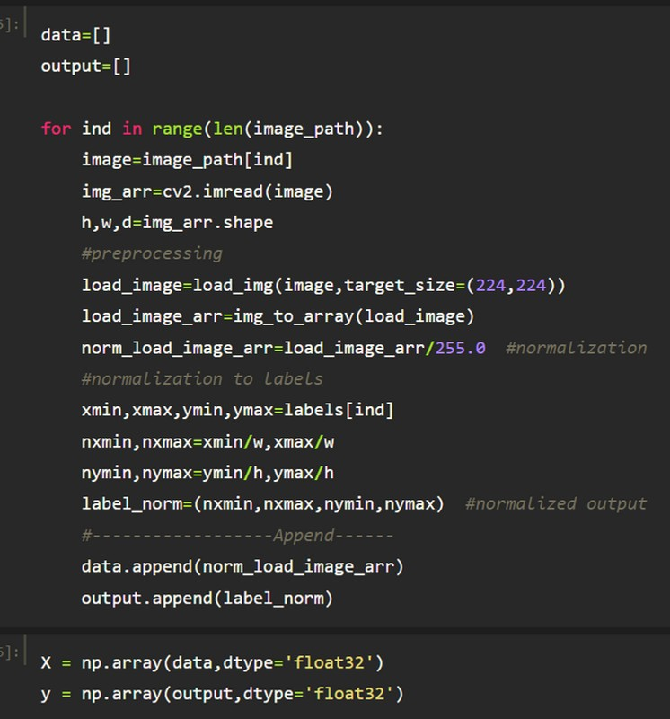

Data Preprocessing
Normalization
Image vs Output (xmin, xmax, ymax, ymin) Normalized Data :
X - Normalized Image Data y - Output

Slide 7






DEEP LEARNING MODELS
Inception ResNetV2
VGG16
Sequential Model

Slide 8
Inception ResNetV2
Why Inception ResNetV2 ?
Pre-trained on more than a million images from the ImageNet database
Consequently, the network has learned rich feature representations for a wide range of images and hence, aligns perfectly with the demands of our VNPR project.
Depth and complexity of the model to capture intricate features and patterns in images

Slide 9
Cont...
Robustness to variations in input images such as lighting, angle, and other factors can affect image quality
Inception ResNetV2 = Inception + ResNet
For VNPR, added a custom head to fine-tune the model that includes 3 dense layers.

Slide 10
Cont...
Model Compilation :
Loss function - Mean Squared Error Optimizer - Adam
Learning Rate - 0.0001
Model Summary :
Total params - 73663490 Trainable params - 19326754
Non-trainable params - 54336736
Model Training :
Batch Size - 10 Epochs - 200

Slide 11
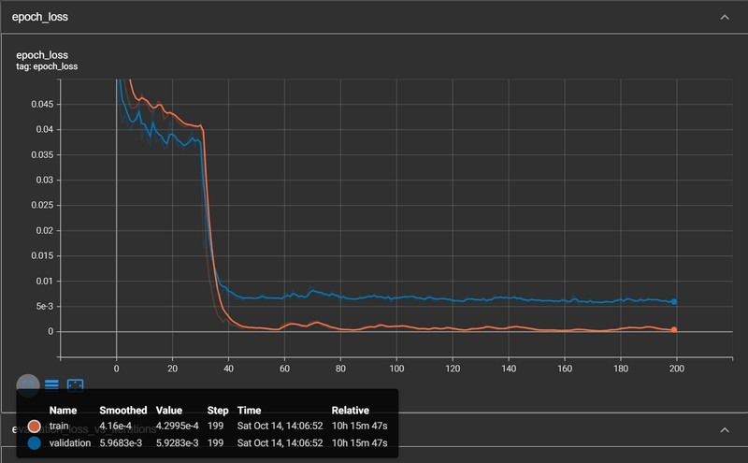
Performance Metrics
loss is inversely proportional to learning
epoch loss is decreasing over time and is relatively low
epoch loss :
Training - 0.00042995
Validation - 0.0059

Slide 12
Inception VGG16
Why Inception VGG16 ?
Pre-trained on more than a million images from the ImageNet database
Consequently, the network has learned rich feature representations for a wide range of images and hence, aligns perfectly with the demands of our VNPR project.
Simple yet effective to execute and achieved better accuracy
For VNPR, added a custom head to fine-tune the model that includes 3 dense layers.

Slide 13
Cont...
Model Compilation :
Loss function - Mean Squared Error Optimizer - Adam
Learning Rate - 0.0001
Model Summary :
Total params - 27385442 Trainable params - 12670754
Non-trainable params - 14714688
Model Training :
Batch Size - 10 Epochs - 200

Slide 14
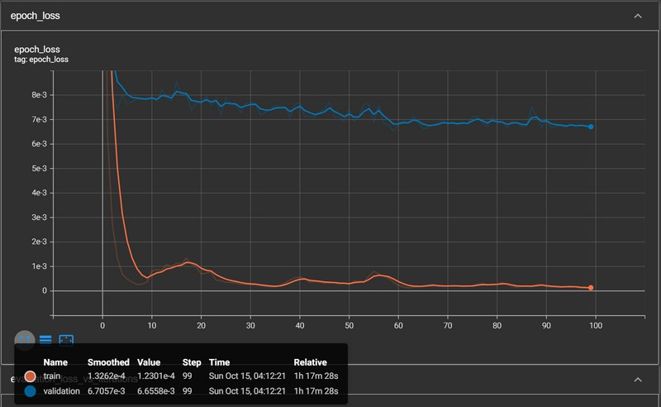
Performance Metrics
loss is inversely proportional to learning
epoch loss is decreasing over time and is relatively low
epoch loss :
Training - 0.00012301
Validation - 0.0067

Slide 15
Sequential Model
Introduce the Sequential model as an alternative approach for VNPR
Total Trainable parameters: 8411460 with 12 layers Model Compilation :
Loss function - Mean Squared Error
Optimizer - Adam Learning Rate - 0.0001
Model Training :
Batch Size - 10 & Epochs - 100

Slide 16
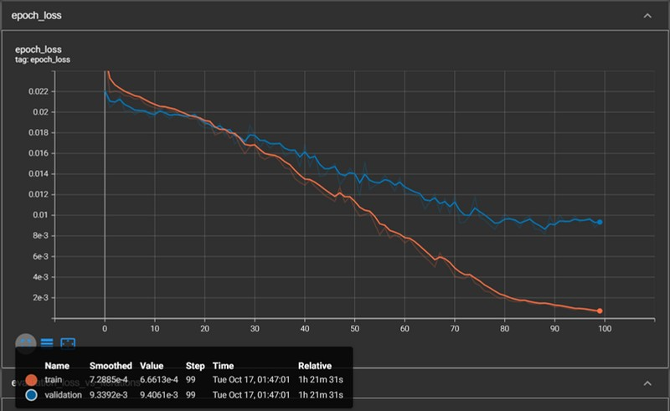
Performance Metrics
loss is inversely proportional to learning
epoch loss is decreasing over time and is relatively low
epoch loss :
Training - 0.0006613
Validation - 0.0094

Slide 17
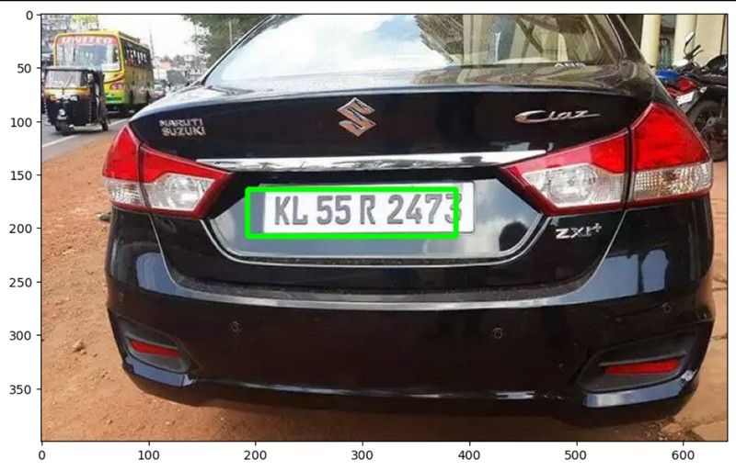
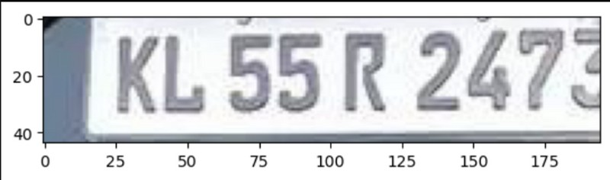
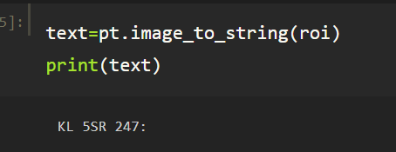
Prediction (Inception ResNetV2)

Slide 18
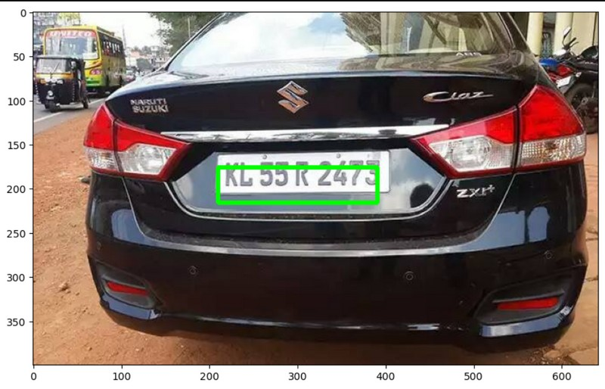
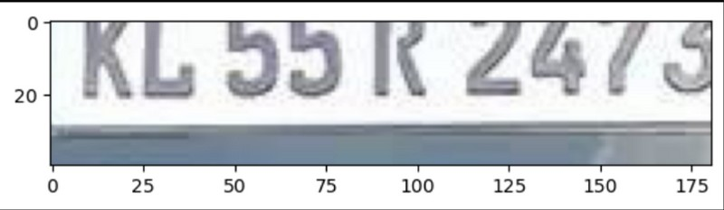
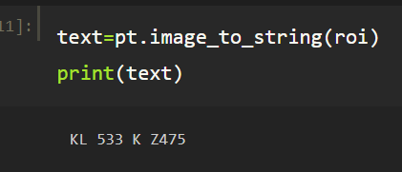
Prediction (VGG16)

Slide 19
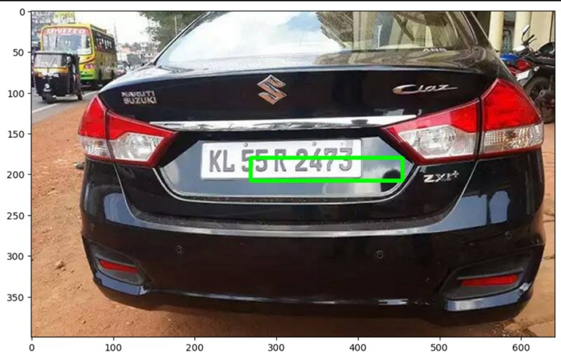
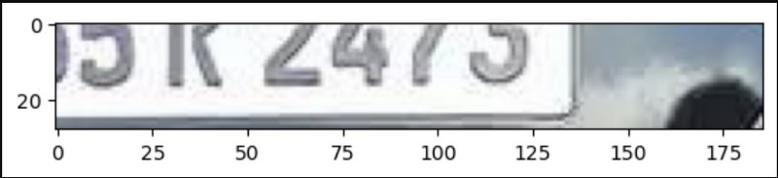
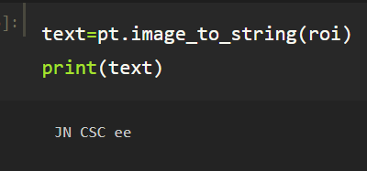
Prediction (Sequential)

Slide 20
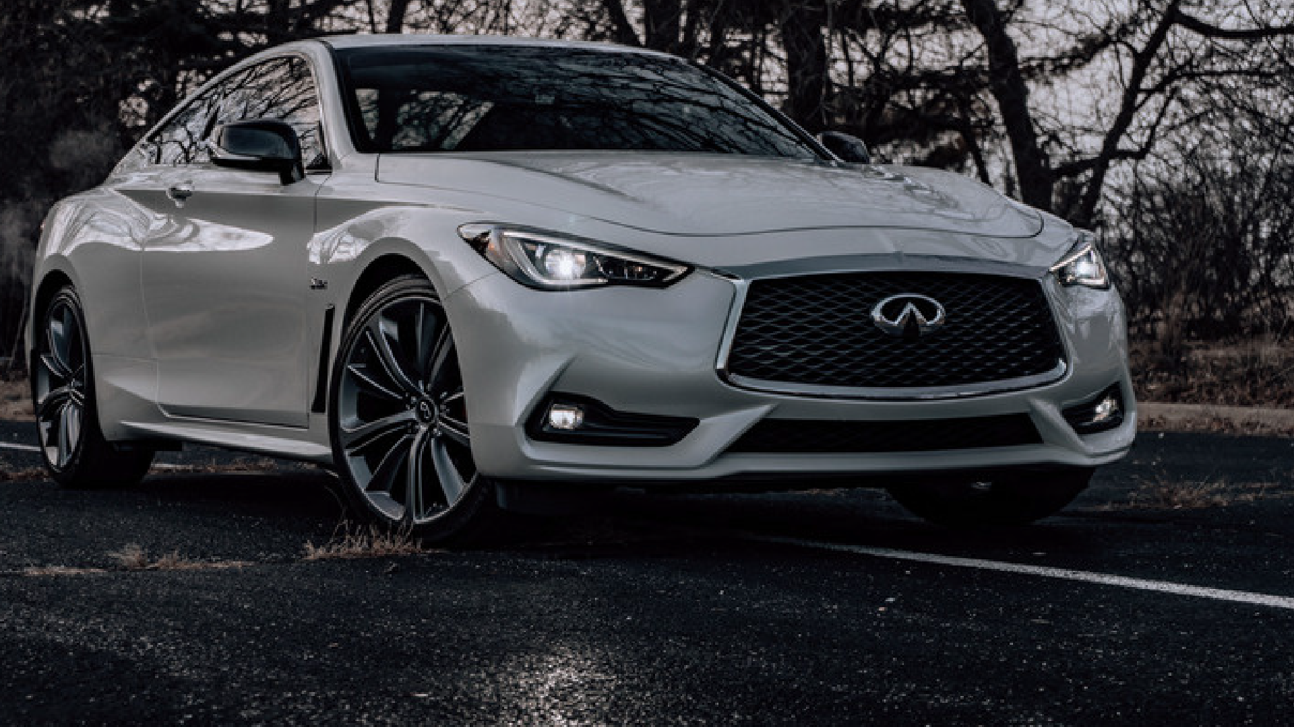

THANK YOU

